Slide 1
Solar Based E-notice Board using GSM
Presented by:
Krishnakumar Marapalli.
Viddhi Sheth.
Vrushali Sheth.
Mayuresh Pujari.

Slide 2
Introduction
Importance of GSM (mobile phones).
Idea behind E-notice Board.
Moto of the proposed model.

Slide 3
LITERATURE SURVEY
Project name | Year | Author | Limitations
GSM Wireless Communication System | 2010 | Guifen Gu and Guili Peng | Communication consumes cost. Its not free service.
Wireless electronic display board using GSM technology | 2013 | N. Jagan Mohan Reddy and G.Venkeshwaralu | Network problem could happens at some palces.
Display message on notice board using GSM | 2013 | Foram Kamdar, Anubbhav Malhotra and Pritish Mahadik | There is limitation of number of cahraters used in SMS.
Transmission policy for multi segment short messages | 2015 | Yi-Bing Lin, Sok-Ian Sou | Limited Characters should be accepted while Transmitting SMS.
A Protocol for End-to-End Secure Transmission of SMS | 2016 | Neetesh Saxena and Narendra S. Chaudhari | Speed of transmission of notices depends on network.

Slide 4
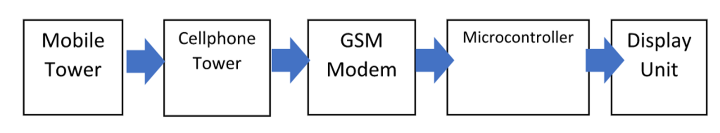
Solar based LED rolling display using GSM
In this project, we are trying to implement our system in such a way that it can display messages from any user that has been sent to the GSM module which is located near the notice board.

Slide 5
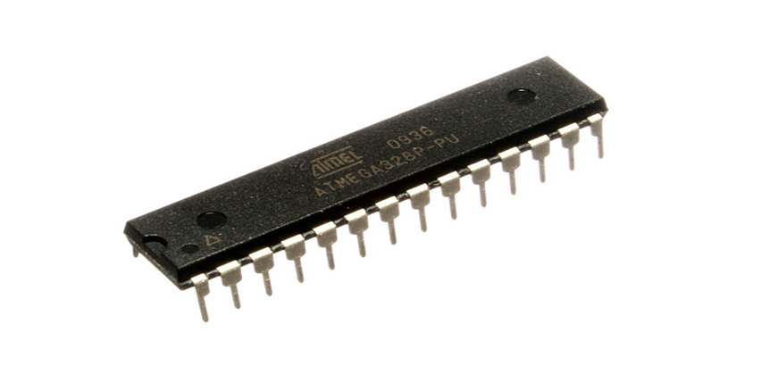
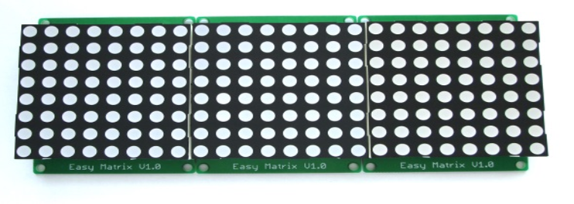
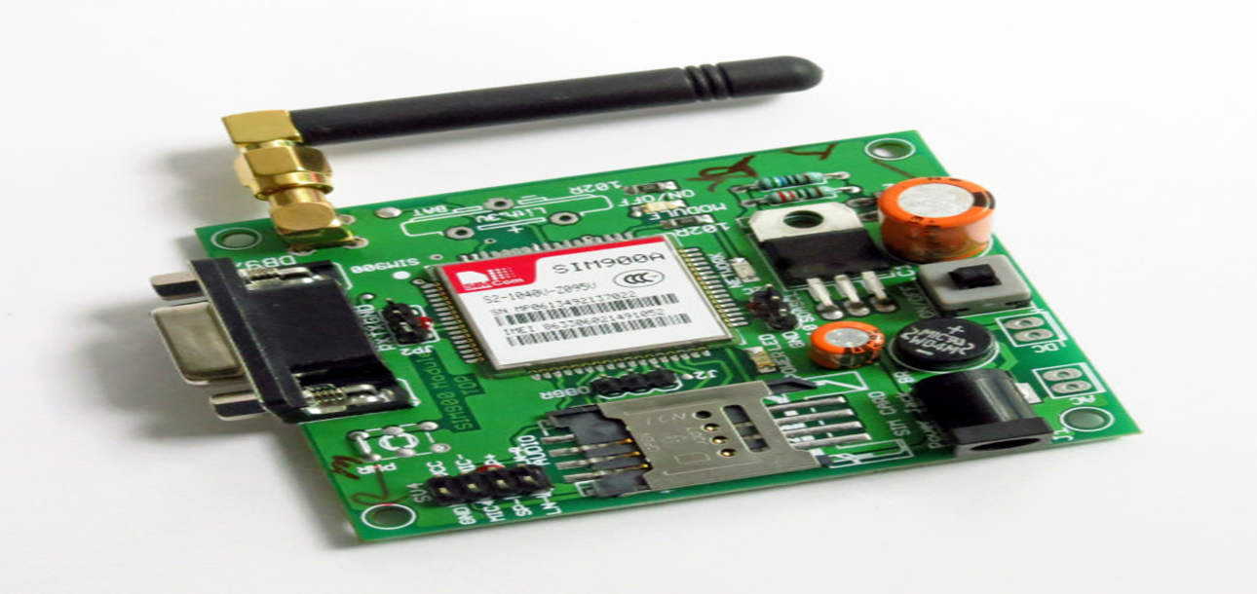
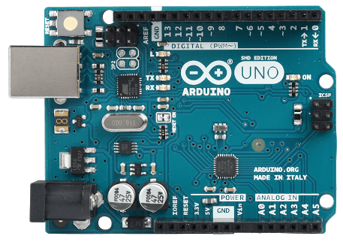
Components
Arduino board.
AT-Mega328.
GSM Modem.
8 x 64 LED Matrix.
Mobile Device.
Solar Panel.

Slide 6


CELLULAR PHONE
GSM MODULE
MAX 232
VOLTAGE CONVERTER
SIM 900A
LED DISPLAY MATRIX
(64 X 8)
AURDINO UNO
ATmega328P
MICRO CONTROLLER
SOLAR PANEL

Slide 7
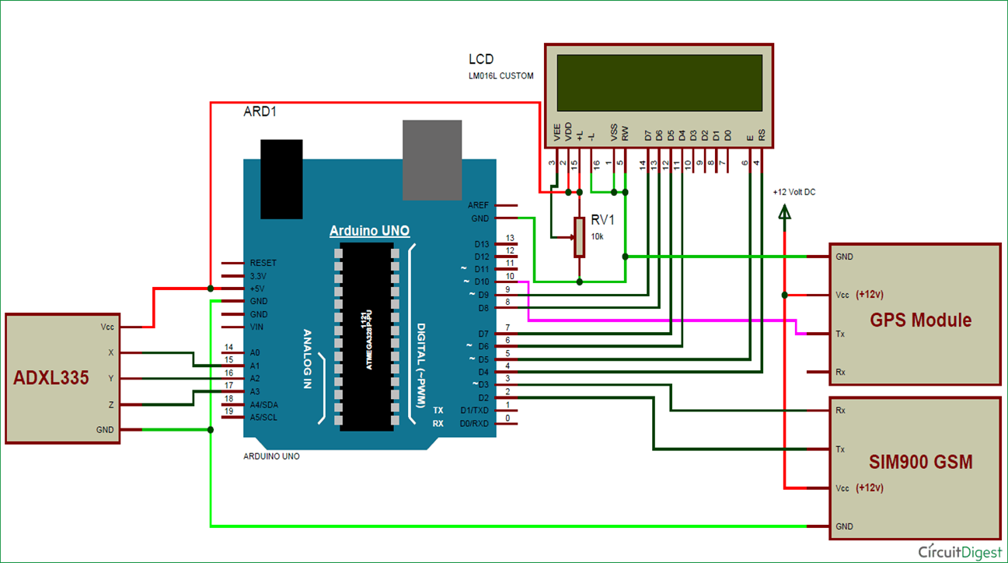
CIRCUIT Diagram
LED

Slide 8
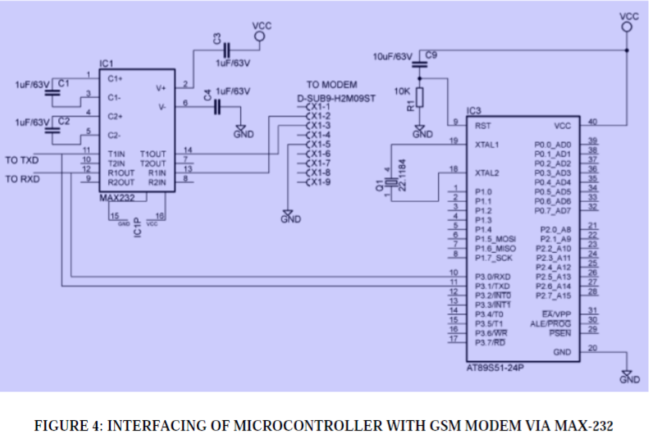
INTERFACE DIAGRAM
INTERFACING OF MICROCONTROLLER WITH GSM MODEM VIA MAX-232

Slide 9
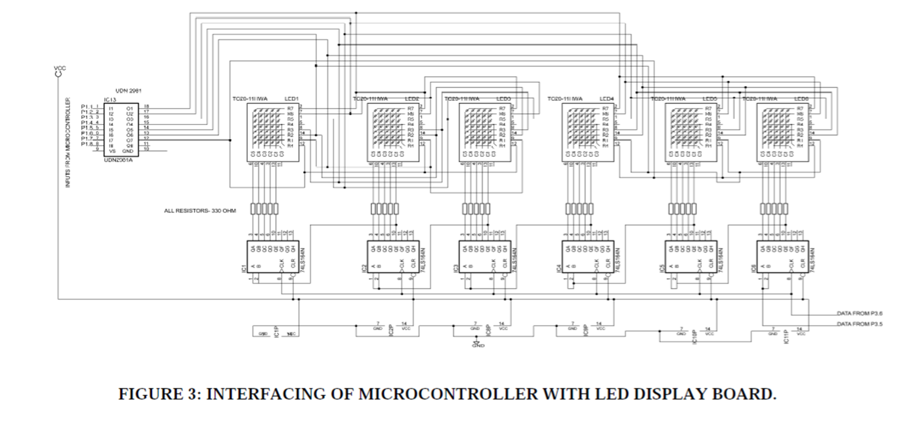
CIRCUIT Diagram
INTERFACING OF MICROCONTROLLER WITH LED DISPLAY BOARD.

Slide 10
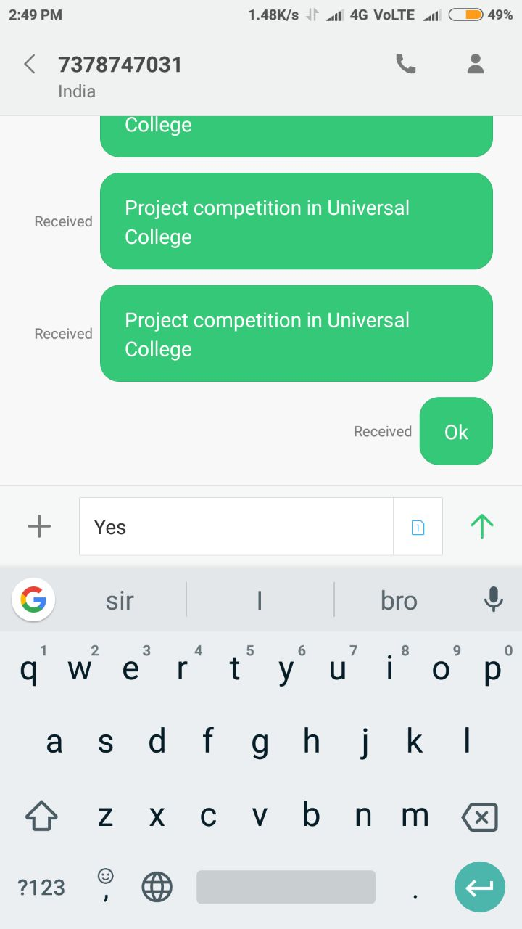
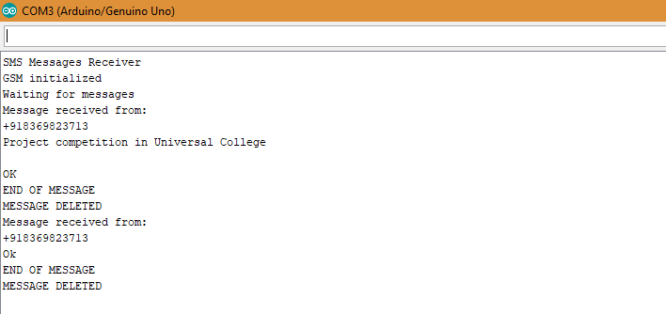
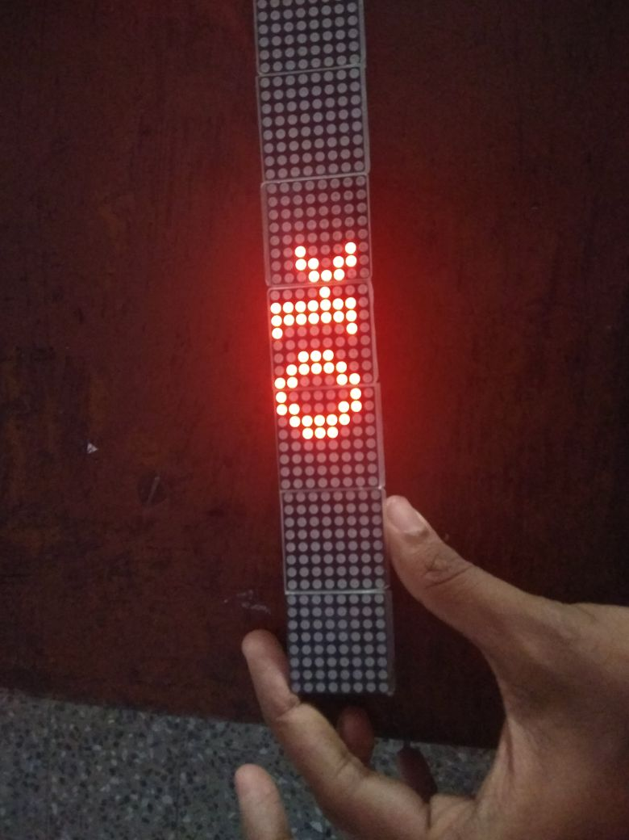
Expected output
C string intake from messenger of mobile.
Visible output from serial monitors.
Visible output from LED matrix Display.
Phone No.
Serial Monitor o/p.
Display o/p.
Message i/p.

Slide 11
Future enhancements
Robots can be controlled in a similar fashion by sending the commands to the robots.
For more security we will implement password based authentication.
Local languages can be added as a variation to this project. This can be achieved by using graphics and other decoding techniques.

Slide 12
Applications
Educational Institutions and Organizations
Managing Traffic
Advertisement
Railway Station
Hospital

Slide 13
conclusion
The display boards are one of the major communication medium for mass media.
This project saves time, energy, electricity and hence environment.
Cost of printing and photocopying is also reduced as information can be given to large number of people from our fingertips.
Thus we conclude that this project is just a start, an idea to make use of GSM in communication to a next level

Slide 14
references
http://www.iraj.in/journal/journal_file/journal_pdf/1-10-139036896650-54.pdf
https://www.ripublication.com/aeee/024_pp%20%20827-832.pdf
https://www.irjet.net/archives/V2/i9/IRJET-V2I910.pdf
https://www.google.co.in/
https://www.wikipedia.org/

